Slide 1

Chapter 13
Generating CSV, PDF, and Other Binary Files

Slide 2

Objectives
This chapter teaches you how to generate files in different data formats, such as CSV, PDF, and other binary file formats (for example, Excel compatible files) using some of the common libraries that are available inside Python.
This knowledge will help you build web projects that let your users export and download records from your site into familiar CSV or Excel-based formats.

Slide 3
Working with CSV Files inside Python
One of the reasons may involve performing analysis of that data – for example, we may need to understand the demographics of users registered on the application or extract patterns of application usage.
We may also need to find out how our application is working for users to design future improvements.

Slide 4
Working with Python's CSV Module
The csv module from Python provides us with the ability to interact with files that are in CSV format, which is nothing but a text file format.
The csv module requires that the file is opened before the methods supplied by the csv module can be applied.

Slide 5

Reading Data from a CSV File
Reading data from CSV files is quite easy and consists of the following steps:
1. First, we open the file:

Slide 6
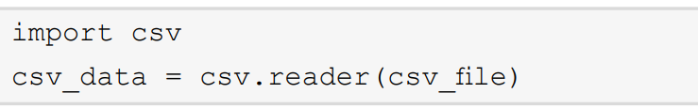
Reading Data from a CSV File
2. Then, we read the data from the file object using the csv module's reader method:

Slide 7
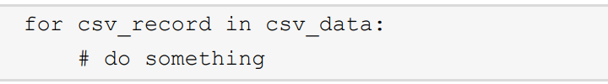
Reading Data from a CSV File
3. Once the data is read by the csv module, we can iterate over this data to perform any kind of operation we may desire. This can be done as follows:

Slide 8

Reading Data from a CSV File
4. Once the processing is done, we close the CSV file simply by using the close() method in Python's file handler object:

Slide 9
Writing to CSV Files Using Python
Writing CSV data follows a similar approach as reading from a CSV file, with some minor differences. The following steps outline the process of writing data to CSV files:
1. Open the file in writing mode:

Slide 10

Writing to CSV Files Using Python
2. Obtain a CSV writer object, which can help us write data that is correctly formatted in the CSV format.

Slide 11
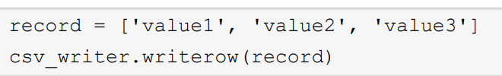
Writing to CSV Files Using Python
3. Once the writer object is available, we can start writing the data. This is facilitated by the write_row() method of the writer object. The write_ row() method takes in a list of values that it writes to the CSV file.

Slide 12

Writing to CSV Files Using Python
4. Once the records are written, we can then close the CSV file.

Slide 13
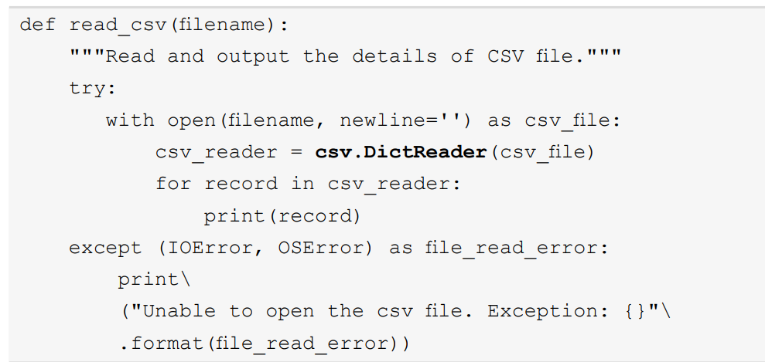
A Better Way to Read and Write CSV Files
If you wanted to parse the code as dict, the implementation of the read_csv() method would need to be changed as shown here:

Slide 14
Working with Excel Files in Python

Slide 15
Binary File Formats for Data Exports
A simple example of this is the open command, which you use to state the format you would like to open a file in.

Slide 16
Working with XLSX Files Using the XlsxWriter Package

Slide 17


The XlsxWriter Python Package
XlsxWriter is an actively maintained package by the developer community, providing support for interacting with XLSX files.
Once installed, you can import the xlsxwriter module as follows.

Slide 18
Creating a Workbook
To start working on XLSX files, we first need to create them. An XLSX file is also known as a workbook and can be created by calling the Workbook class from the xlsxwriter module as follows.

Slide 19
Creating a Worksheet
Before we can start writing data to an XLSX file, we first need to create a worksheet. This can be done easily by calling the add_worksheet() method of the workbook object we obtained in the previous step.

Slide 20
Writing the Data to the Workbook
Once all the data is written, to finalize the written datasets and cleanly close the XLSX file, you call the close() method on the workbook.

Slide 21
Summary
In this chapter, we looked at how we can deal with binary files and how Python's standard library.
Which comes pre-loaded with the necessary tools, can allow us to handle commonly used file formats such as CSV.
We then moved on to learning how to read and write CSV files in Python using Python's CSV module.

